Slide 1
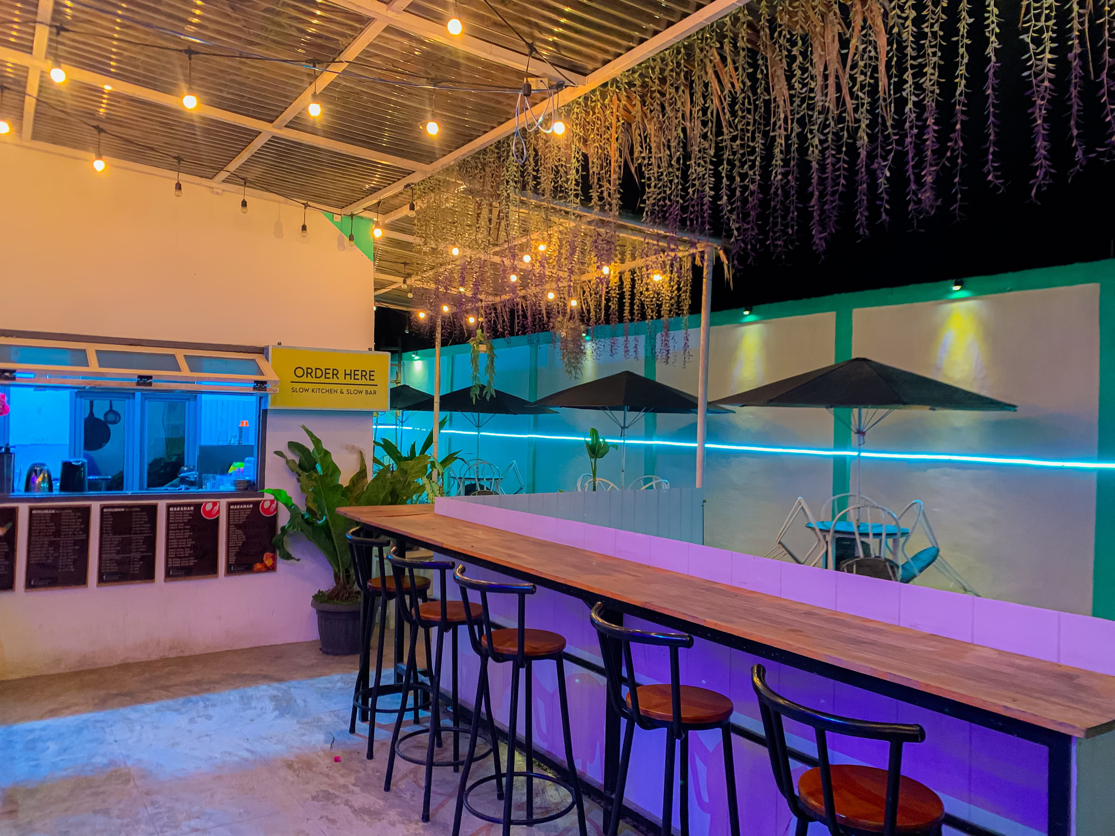


Rancang Bangun Website Café Friendzone
D3 Information Techology Study Program
Institut Teknologi Del
Presented By
Group 12

Slide 2


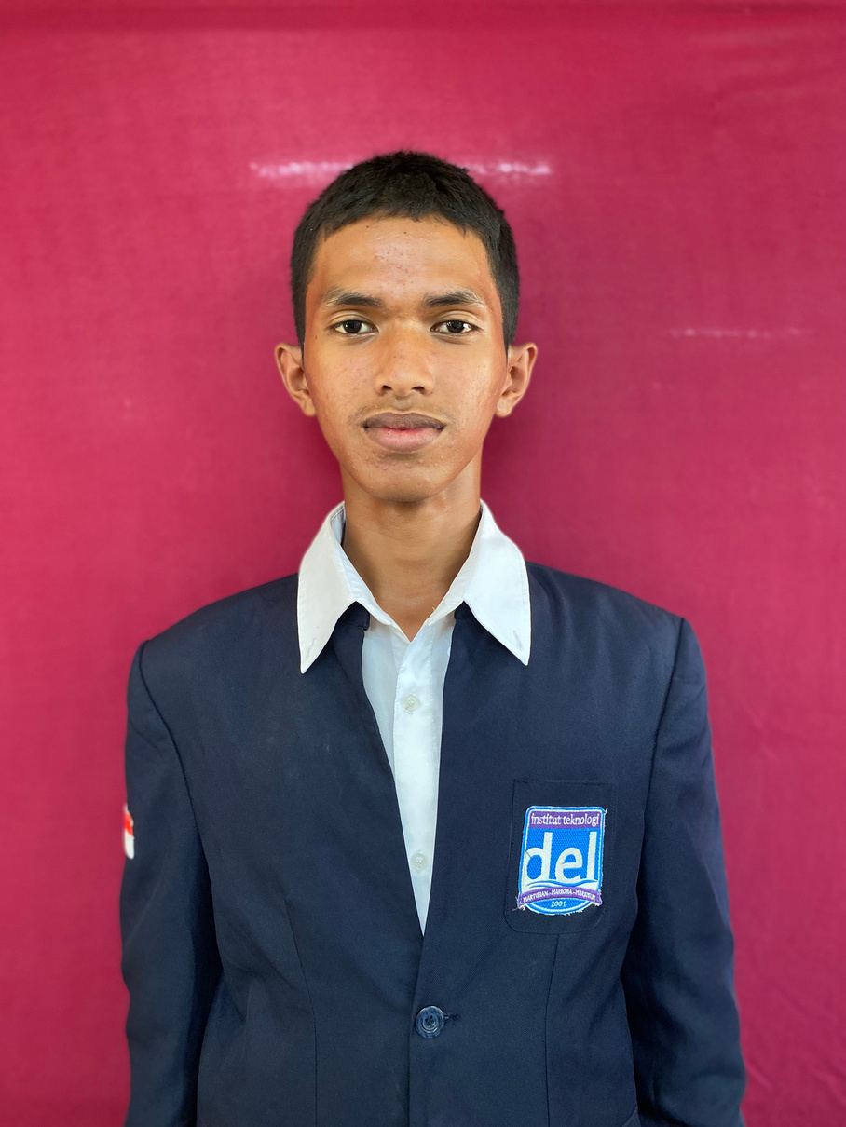

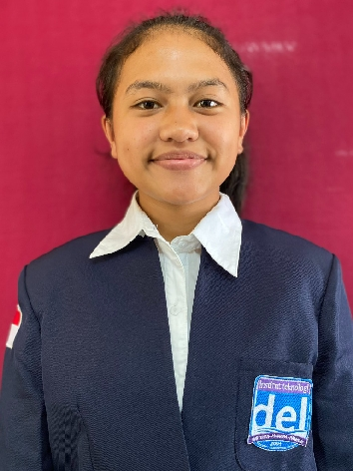
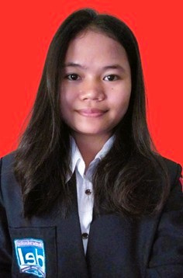


Grup 12
FELIX SIMANJUNTAK
11322013
CHRISTIAN PANJAITAN
11322028
KESIA SIHOMBING
11322042
DIAN SITANGGANG
11322058

Slide 3
Contents
01. Executive Summary
02. Current System Condition (BPMN)
03. Target System Condition
04. Target System Condition (BPMN)
05. Functions in the information system
06. Usecase Diagram
07. Entity Relationship Diagram
08. Conceptual Data Model
09. Physical Data Model
10. Class Diagram
11. Sequence Diagrams
12. Package Diagram
13. Demo

Slide 4
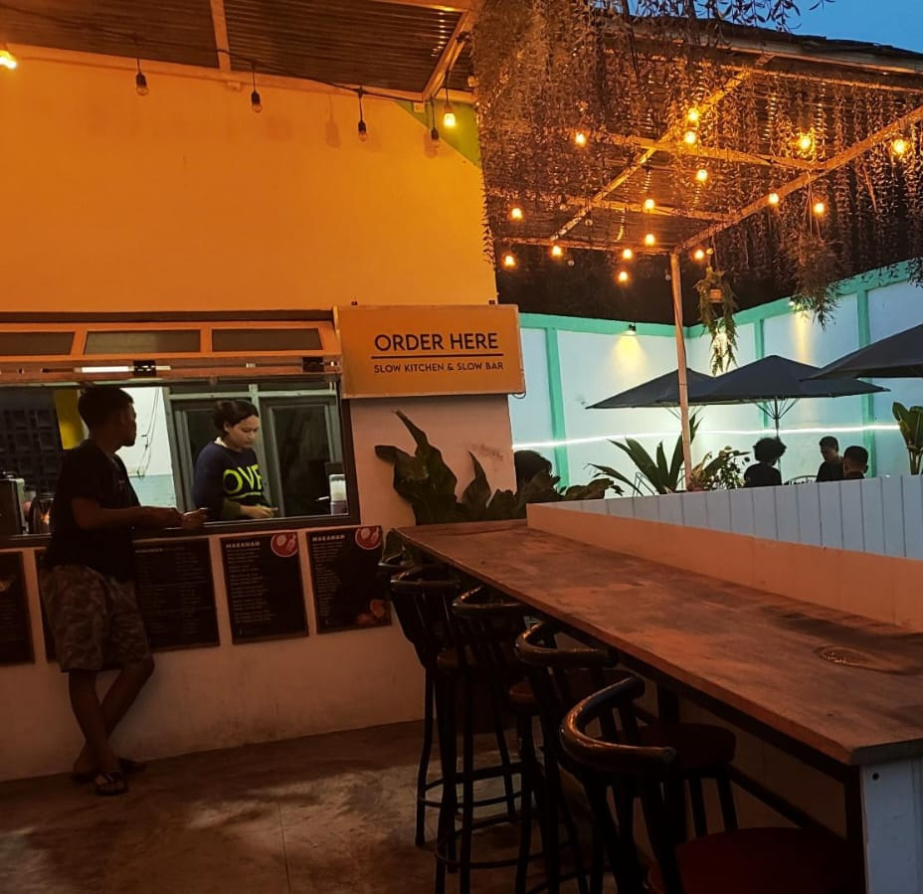
Executive Summary
The Cafe Friendzone website is currently facing issues with the manual reservation system for tables and food, leading to low efficiency and long queues. Orders placed via WhatsApp take a long time and often get buried among other messages, making it difficult for the admin to handle orders quickly. Additionally, customers lack information about the cafe's address and menu.

Slide 5
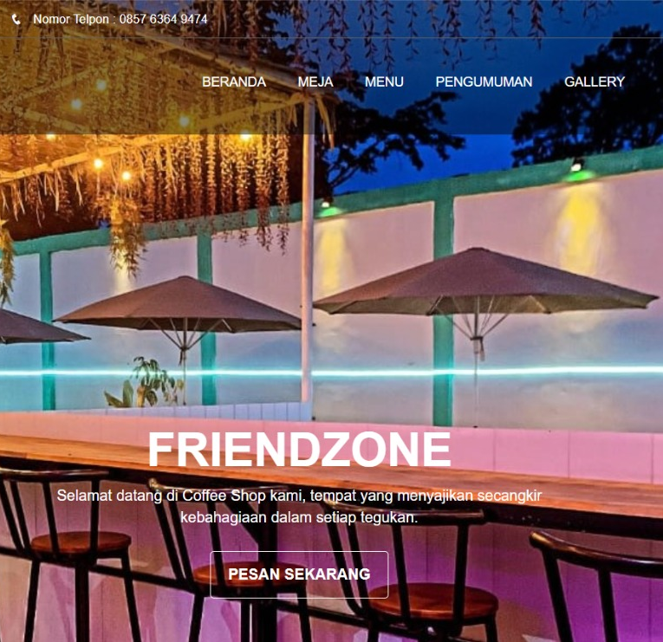
Executive Summary
To address these issues, an integrated and efficient reservation system via a website or app is needed, allowing customers to easily and quickly book tables and order food. Therefore, our team is developing an information system titled “Design and Development of the Cafe Friendzone Website.” This website is expected to improve the business operations of Cafe Friendzone.

Slide 6
Current System Condition (BPMN)

Slide 7
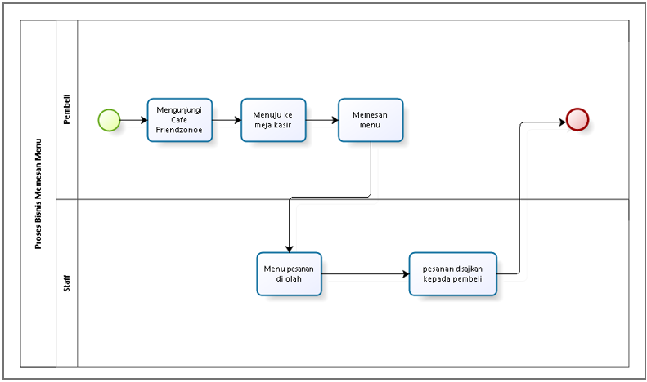
Order Business Process

Slide 8
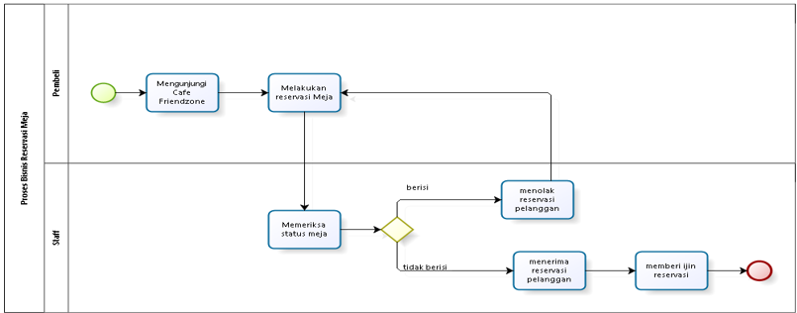
Table Reservation Business Process

Slide 9
Target System Condition
Enhancing Cafe Management Efficiency and Effectiveness
Improving Customer Satisfaction
Provide an easy way to make table reservations and order food online.
Increasing Reservations, Sales, and Revenue
Increase sales by simplifying the food ordering process.
Reducing Operational Costs
Lower costs associated with manual reservation and ordering management.
Presenting a Modern and Professional Image
Showcase the cafe with a modern and professional image through a user-friendly website.
Highlight technological advantages in cafe management.

Slide 10
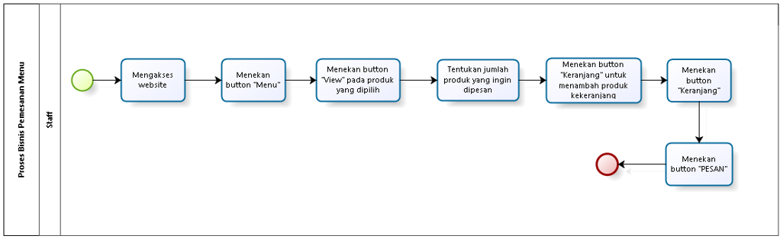
Menu Ordering Business Process

Slide 11
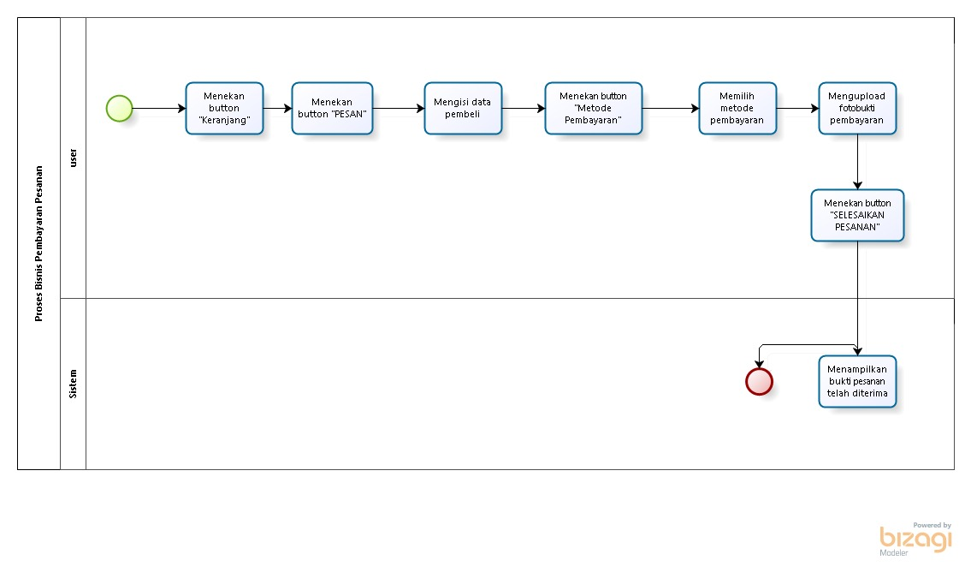
Payment Processing Business Process

Slide 12
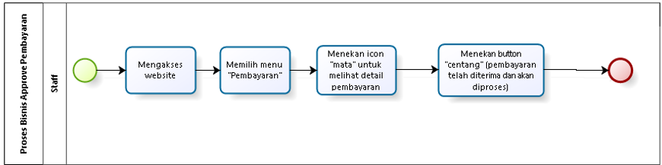
Payment approve Business Process

Slide 13
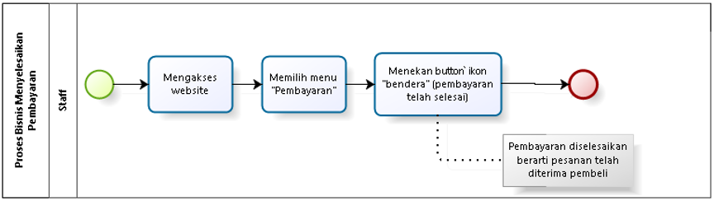
Order Payment Completion Business Process

Slide 14
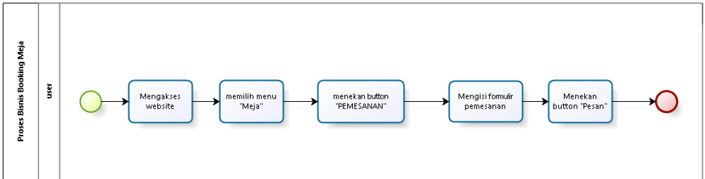
Table Booking Business Process

Slide 15
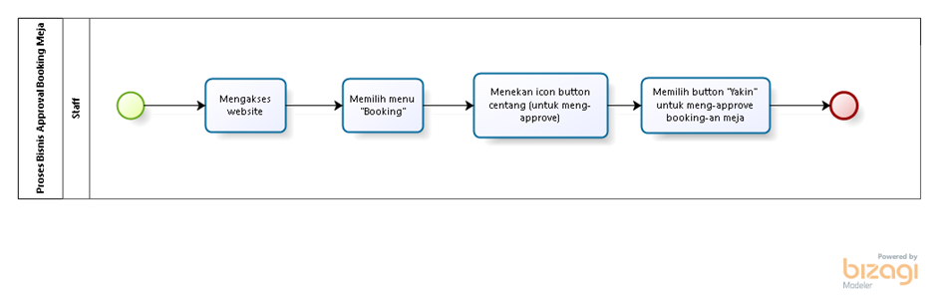
Table Booking Approval Business Process

Slide 16
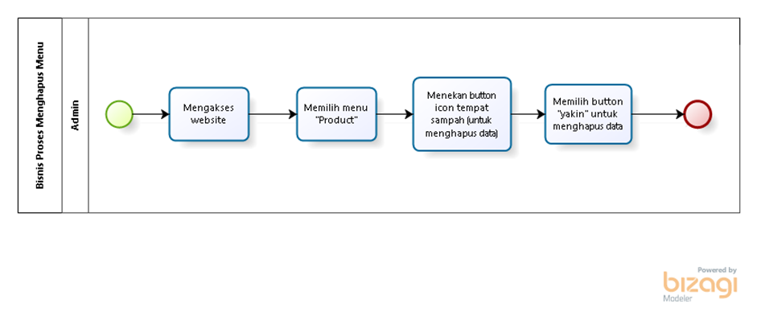
Table Booking Complete Business Process

Slide 17
Functions in the information system
System functions will be provided directly to Café Friendzone Website users. The following are functions on the web, each of which has its uses.
1. Authentication Function
2. Manage table function
3. Menu Managing Function
4. Approval, Reject and Complete Booking Table functions
5. Menu Ordering Function
6. Payment Function
7. The payment function is carried out by the user when paying
8. Payment management function
9. Function of Making Criticism and Suggestions
10. Function for deleting criticism and suggestions
11. Gallery Management Function
12. Announcement Management Function
13. Table Booking Function
14. Manage Cart Function
15. Function to Add Ratings
16. Search Function
17. Notification Viewing Function
18. History Viewing Function

Slide 18
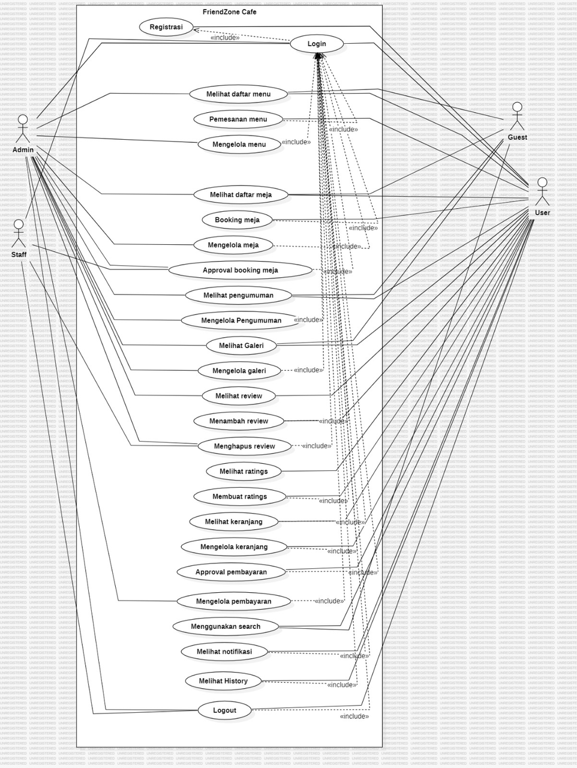
Usecase Diagram
A Use Case Diagram is a type of behavioral diagram defined by and created from a Use-case analysis. Its purpose is to present a graphical overview of the functionality provided by a system in terms of actors, their goals (represented as use cases), and any dependencies among those use cases.
Role actor : Admin, Staff, User, and Guest

Slide 20
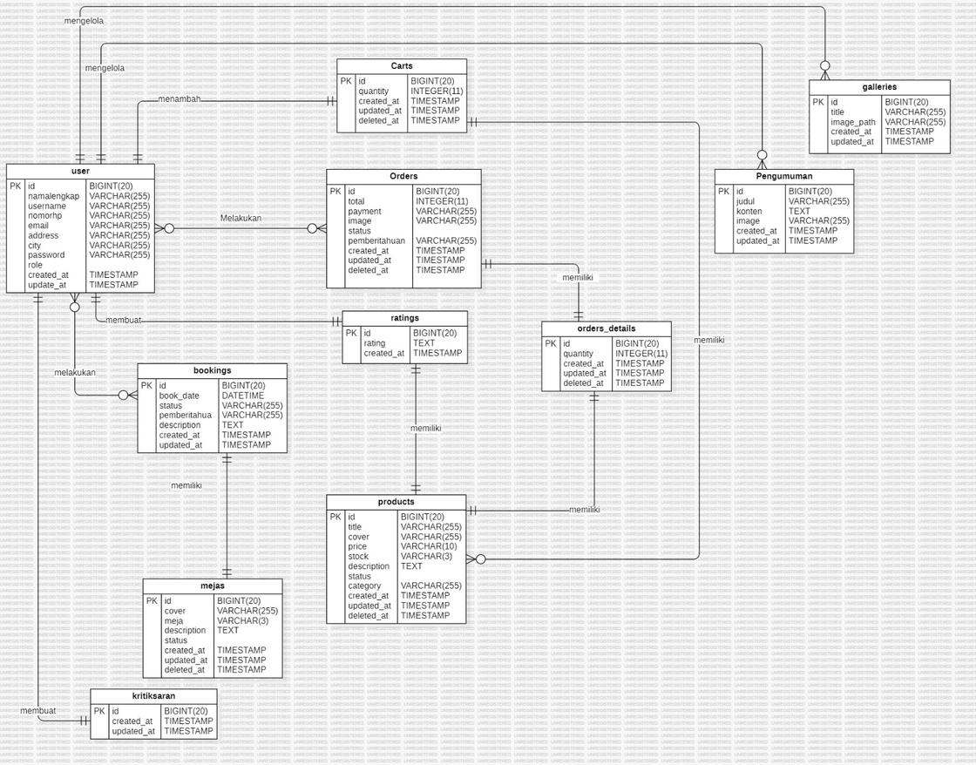
Entity Relationship Diagram
An Entity-Relationship Diagram (ERD) is a type of structural diagram used in database design. It illustrates the entities within a system and the relationships between those entities.

Slide 21
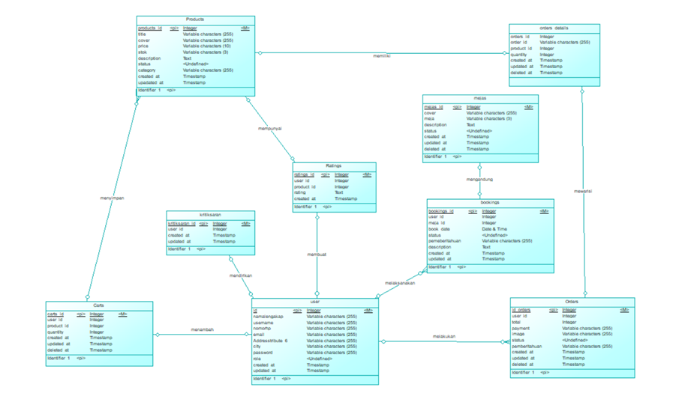
Conceptual Data Model
A Conceptual Data Model (CDM) is a high-level data model that defines the structure of the data elements and the relationships among them. It focuses on the business requirements and is often used as a communication tool between stakeholders and developers.

Slide 22
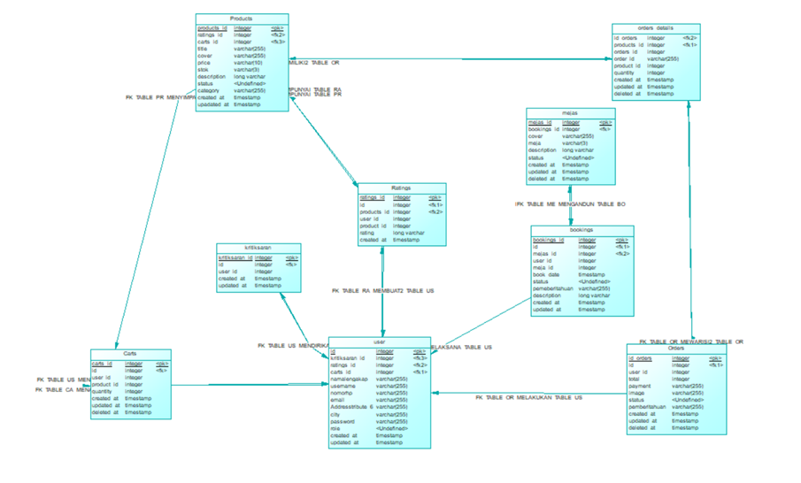
Physical Data Model
A Physical Data Model (PDM) describes the implementation of the database on a specific database management system. It includes detailed specifications for the database schema, including tables, columns, data types, indexes, and constraints.

Slide 23
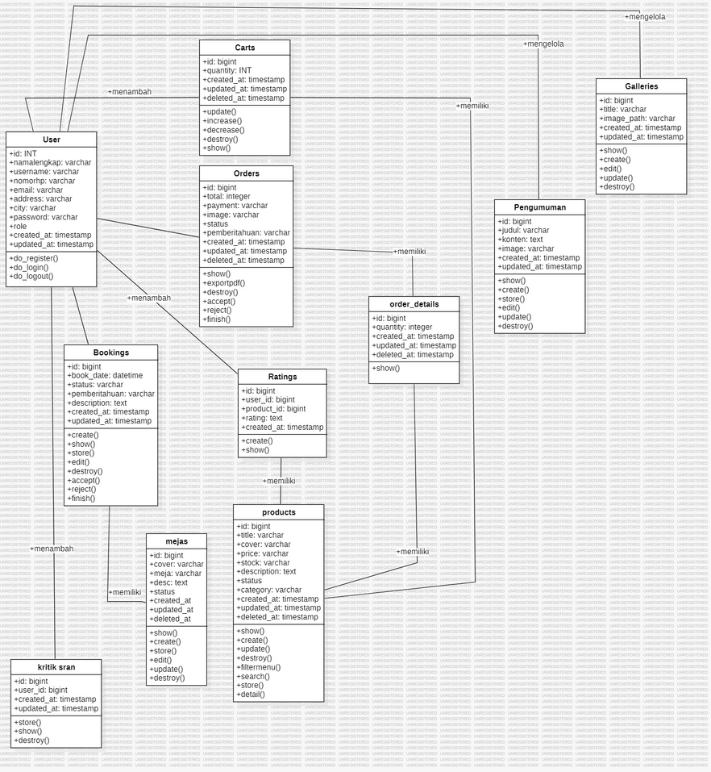
Class Diagram
A Class Diagram is a type of static structure diagram in UML (Unified Modeling Language) that describes the structure of a system by showing its classes, attributes, methods, and the relationships among objects.

Slide 24
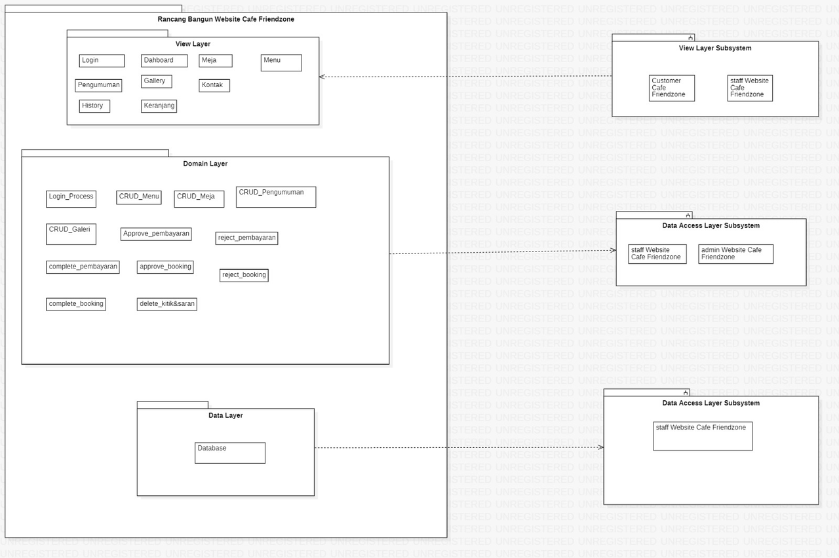
Package Diagram
A Package Diagram is a type of structural diagram in UML that depicts the organization and arrangement of various model elements in the form of packages. It shows the dependencies between different packages, allowing for a high-level view of the system's organization.

Slide 25
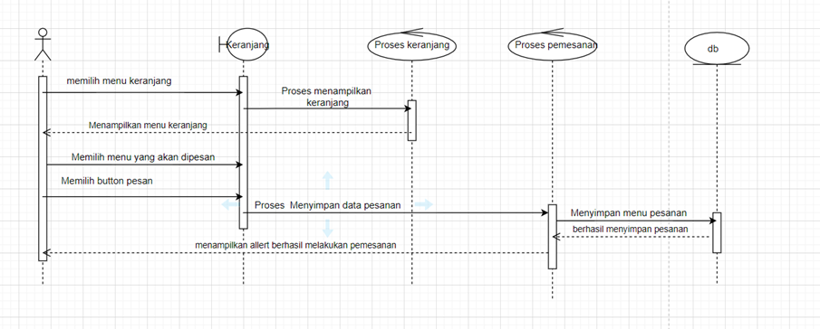
Sequence Diagram
Sequence Diagram User Places an Order

Slide 26
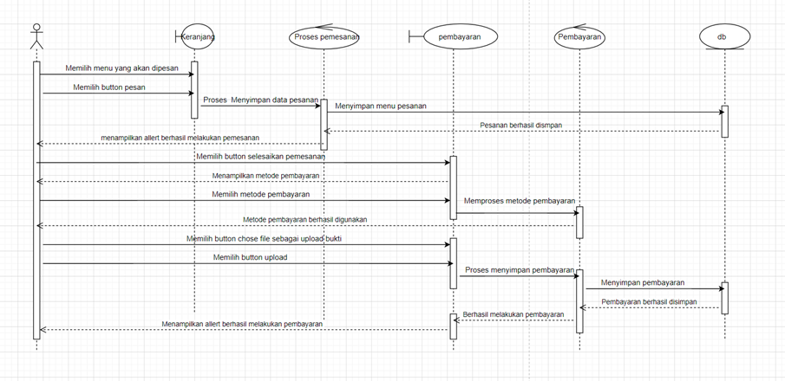
Sequence Diagram
Sequence Diagram User Makes Payment

Slide 27
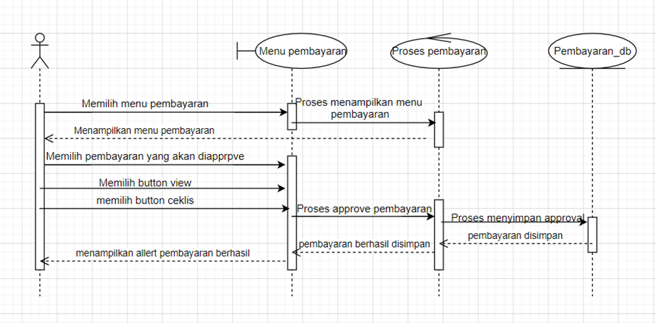
Sequence Diagram
Sequence Diagram Staff Approve Payments

Slide 28
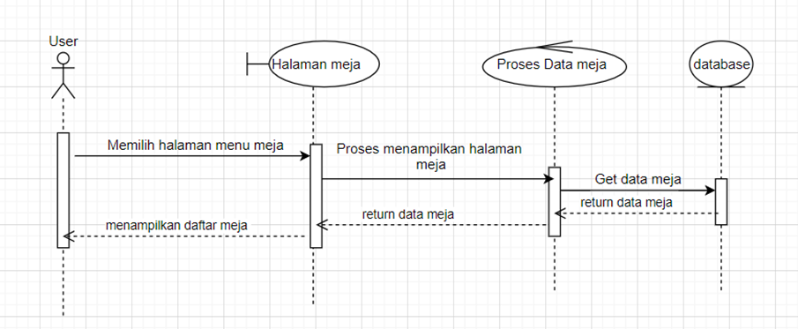
Sequence Diagram
Sequence Diagram User Views Table List

Slide 29
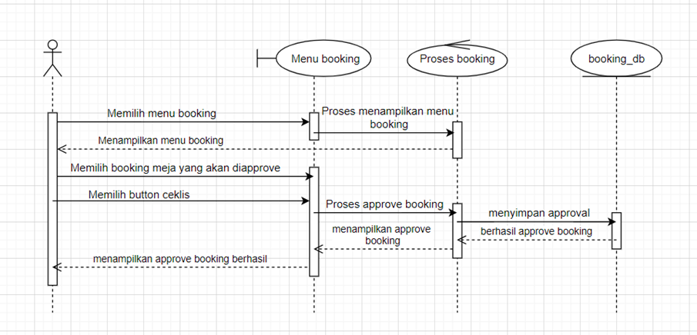
Sequence Diagram
Sequence Diagram Staff Approve Tables booking

Slide 30

DEMO
Presented By
Group 12

Slide 31
